Slide 1

Talend ESB
Module Code : ESB02
By : Muhammad Faris Ashim

Slide 2
Agenda
Define Webservice
Explain a standar webservice use case
Create a webservice in Talend Studio
Test a webservice using dedicated client
Create a job to consume a web service
2

Slide 3


Talend ESB Basics
REST Web Services

Slide 4
REST web services
REST web services expose a resource. They make the resource available with four basic operations: GET, POST, PUT, and DELETE.
GET allows you to SELECT data from the resource
POST allows you to INSERT data in the resource
PUT allows you to UPDATE data in the resource
DELETE allows you to DELETE data in the resource
REST services are queried simply by calling a URL
4

Slide 5
REST vs SOAP
 | SOAP | REST
Meaning | Simple Object Access Protocol | Representational State Transfer
Design | Standardized protocol with pre-defined rules to follow. | Architectural style with loose guidelines and recommendations.
Approach | Function-driven (data available as services, e.g.: “getUser”) | Data-driven (data available as resources, e.g. “user”).
Statefulness | Stateless by default, but it’s possible to make a SOAP API stateful. | Stateless (no server-side sessions).
Caching | API calls cannot be cached. | API calls can be cached.
Disadvantages | Poorer performance, more complexity, less flexibility. | Less security, not suitable for distributed environments.

Slide 6
REST vs SOAP
 | SOAP | REST
Security | WS-Security with SSL support. Built-in ACID compliance. | Supports HTTPS and SSL.
Performance | Requires more bandwidth and computing power | Requires fewer resources.
Message format | Only XML. | Plain text, HTML, XML, JSON, YAML, and others.
Transfer protocol(s) | HTTP, SMTP, UDP, and others. | Only HTTP
Recommended for | Enterprise apps, high-security apps, distributed environment, financial services, payment gateways, telecommunication services. | Public APIs for web services, mobile services, social networks.

Slide 7

REST web services: example
A Talend runtime server exposes a REST web service on the intranet. This service provides access to a company resource: the product catalog.
7

Slide 8

REST web services: example, continued
This web service-client machine needs to get product information by querying the REST service.
8

Slide 9
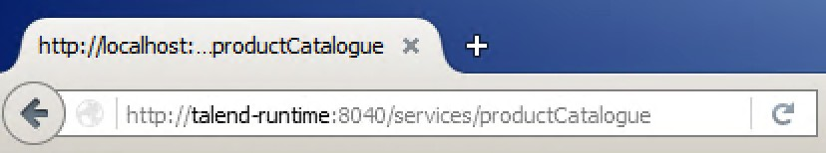
REST web services: example, continued
The client sends a web service request via HTTP to the REST web service
9

Slide 10
REST web services: example, continued
The server receives the request and analyzes the requested action.
Then it accesses the resource to complete the request.
10

Slide 11
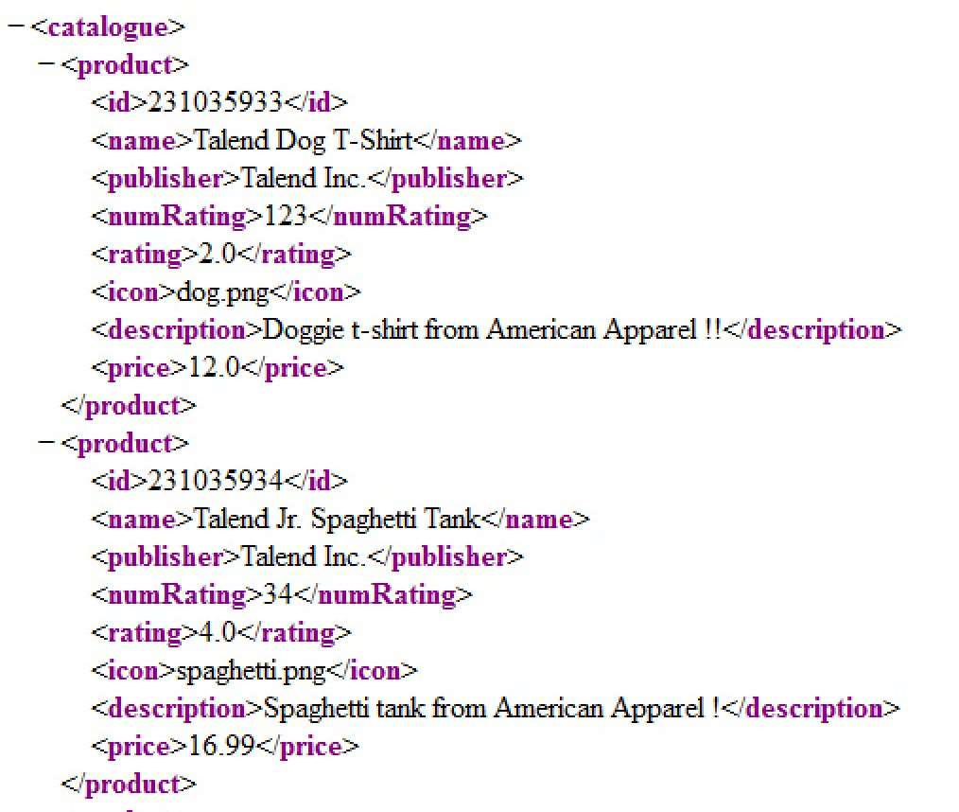
REST web services: example, continued
The server sends a response message to the web service client.
11

Slide 12
Creating a REST web service
REST web services do not need a contract (as opposed to the WSDL file in the SOAP standard)
A REST service is accessible via a simple URI and an HTTP verb: GET, POST, PUT, or DELETE
130

Slide 13
Creating a REST web service, continued
A complete REST URI consists of:
The REST endpoint--the root address on which the service is exposed
the URI pattern--it completes the REST endpoint to specify which resource to access
http://localhost:8040/myService/productCatalog
REST endpoint
URI pattern
13

Slide 14
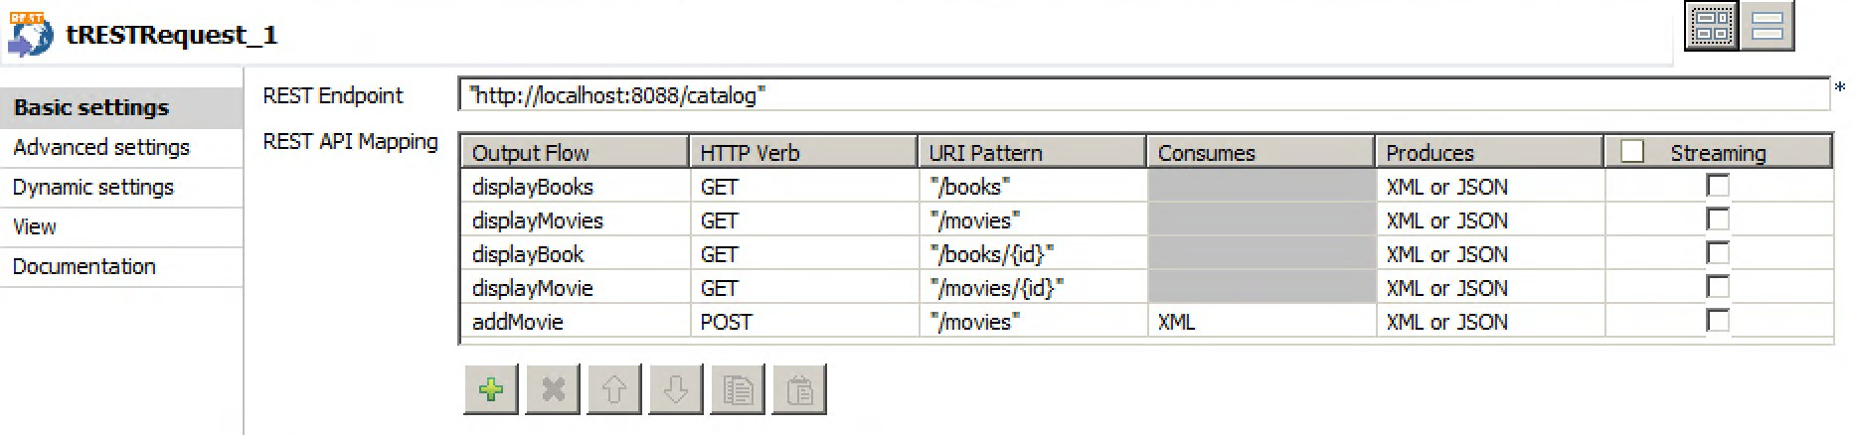
Creating a REST web service, continued
To create a REST web service in Talend Studio, create a Job and designate a tRESTRequest component as the main input component
This component defines the REST endpoint as well as the available URI patterns and their HTTP verbs
14

Slide 15

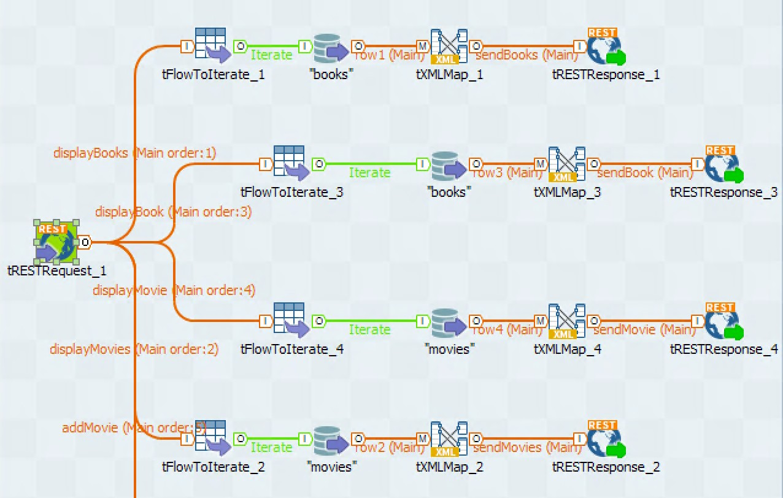
Creating a REST web service, continued
Each unique combination of REST endpoint, URI pattern, and HTTP verb results in a new flow leading to its own process
15

Slide 16
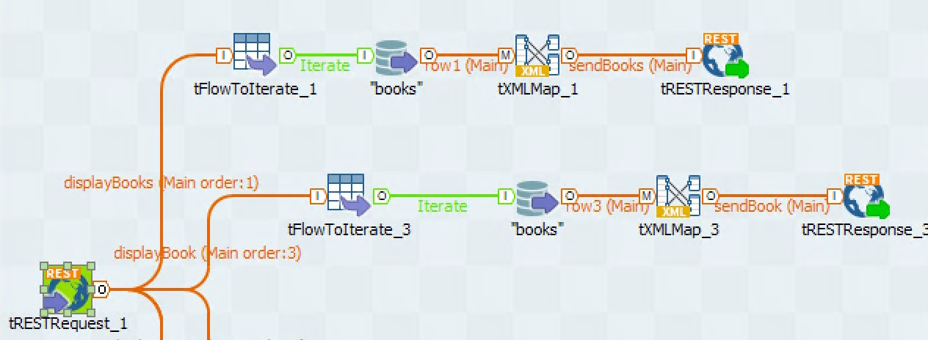
Creating a REST web service, continued
The output component for a REST service is the tRESTResponse component, which is in charge of sending the response back to the service consumer
16

Slide 17
Lab overview
In this lab, you will:
Create REST services to access a database using the HTTP operations GET and POST
Create a DI Job to consume your REST web services
17

Slide 18
Thank You

